Slide 1
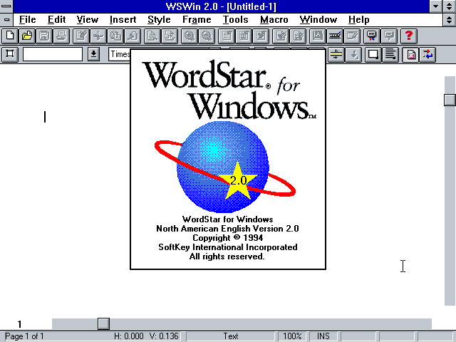
WordStar Software
Performed by fred nekrasov

Slide 2
The history of the creation and popularity of WordStar
WordStar is a word processor for microcomputers. Seymour Rubenstein first started developing an early version of a word processor for the IMSAI 8080 computer when he was director of marketing for IMSAI. He left to start MicroPro International Inc. in 1978 with only $8,500 in cash.
At Rubenstein’s urging, software programmer Rob Barnaby left IMSAI to join MicroPro. Barnaby wrote the 1979 version of WordStar for CP/M, the mass-market operating system created for Intel’s 8080/85-based microcomputers by Gary Kildall, released in 1977. Jim Fox, Barnaby’s assistant, ported (meaning rewrote for a different OS) WordStar from the CP/M OS to MS/PC DOS, the by then a famous OS introduced by Microsoft and Bill Gates in 1981.
The 3.0 version of WordStar for DOS was released in 1982. Within three years, WordStar was the most popular word processing software in the world. However, by the late 1980s, programs like WordPerfect knocked WordStar out of the word processing market.

